Slide 1

REPL Driven
Development
Dan Lebrero
Prague, 18-19 October 2018

Slide 2

Notes:
But before we get started, I have a confession to make. On my very first job I got to work with 3 technologies that made a profound and lasting impact on my career as a developer. Those 3 technologies were Netscape, IE4 and IE5. Thanks to those technologies, I decided to become a BE developer and I have avoided any kind of FE related work for a very long time, being a happy Java developer living on a world of XML and JSON. But in a recent project, I ended up working hand in hand with a team of FE developers, and I have to admit that since that project, I have been really jealous of the FE guys. You may be wonder what makes me so jealous?

Slide 3
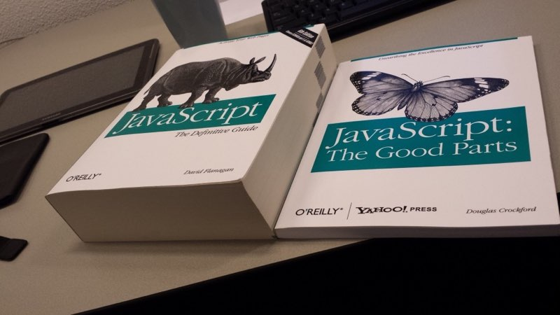
Notes:
Maybe the JS that they use was somehow different from the JS that I learned and suffer 15 years ago? A little but not enough.

Slide 4
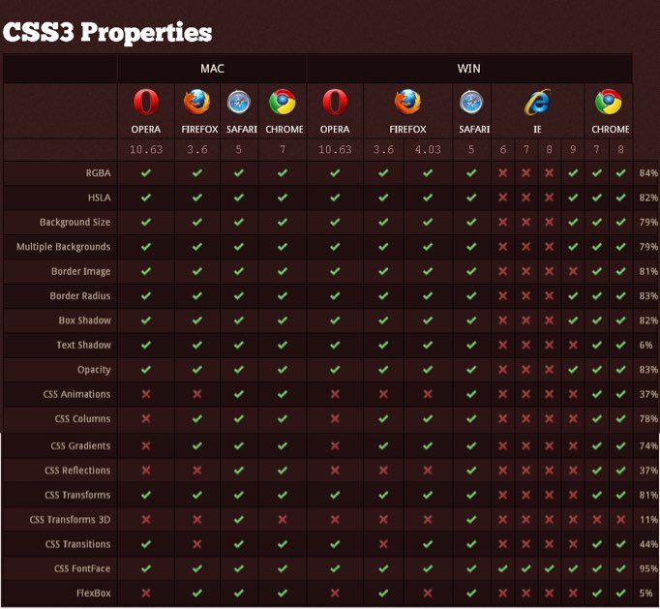
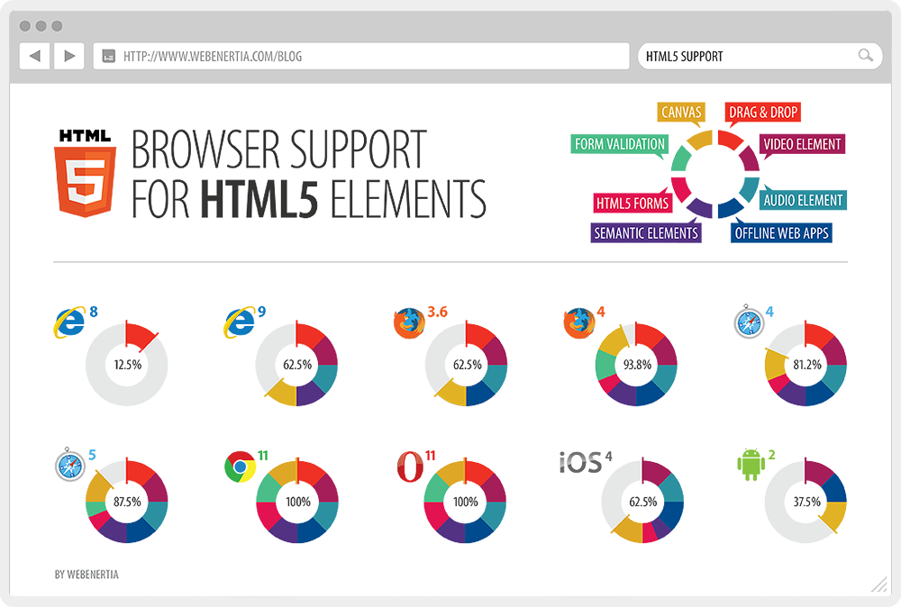
Notes:
Maybe they have fixed all those incompatibilities between browsers that used to drive me mad?
Nop, they still exists.
So, to understand why I am really jealous about the FE developers, lets see a picture of myself doing some FE work

Slide 5
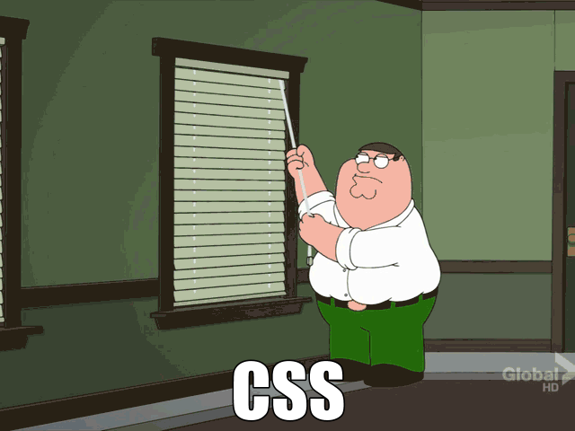
Notes:
Yeah, that is me trying to get a 2 column layout working in IE and Opera, and as you can see I am not very good at it, and as much as I try and I try, I always end up with the same end result, a pile a crap. But even if CSS doesn't make any sense to me at all, there is something really nice on this picture. Lets watch it again.

Slide 6
Notes:
Focus on Mr. Griffin’s workflow. See how he pulls from a string and he sees straight away, without any delay the effect on the blind. And if he doesn't like what he sees, he just pulls the string in a different direction. And he keeps pulling and pulling until he is done. This is what I really really miss on my day to day job.

Slide 7
Immediate Feedback
Notes:
This is what makes me jealous of the FE devs. That immediate feedback.
We know from Agile, Scrum and Lean, that feedback loops are important and the shorter the feedback loop, the better. But why is this immediate feedback so important during development?

Slide 8
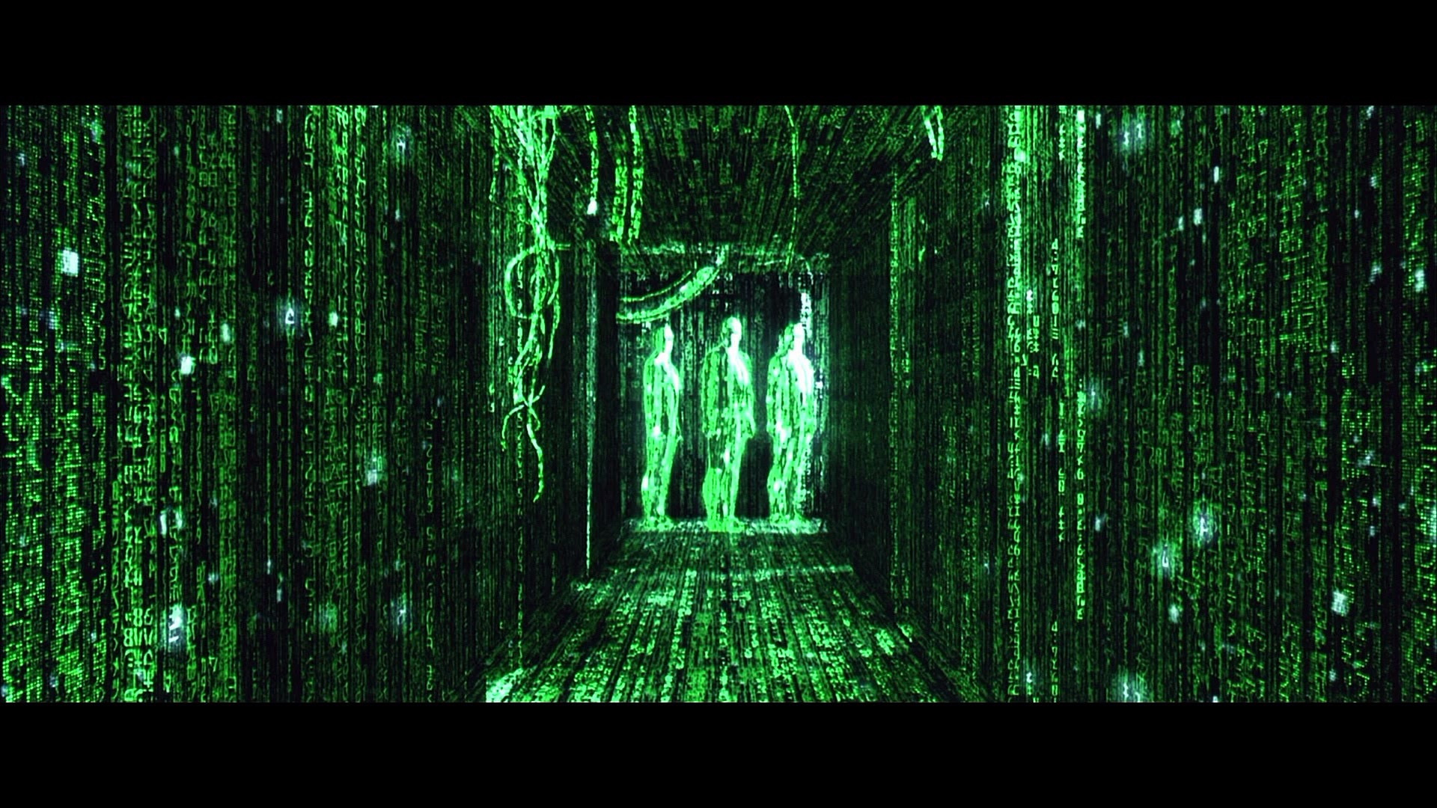
Notes:
Because without that immediate feedback, it is very hard to get into the Zone or the Flow.
The Zone is that state where you feel like Neo when he realises that he is the chosen one. It is just you and the code. You are so focus, that the real world disappears, and instead you can see with absolute clarity your application, its code, its design and the data flowing around it.
When you are in the Flow no problem is difficult enough, no bug can hide from you and your solutions are simple, clean and elegant.

Slide 9
Productivity
Notes:
When you are in the flow is when you are the most productive, and not only are you able to produce more, but what you produce, the code and its design is of a better quality.
But this productivity is just a nice side effect of being in the flow.

Slide 10
Joy
Notes:
What we are looking for is that feeling of joy, that feeling of achievement, that feeling of creating something truly beautiful.
And is this feeling is why I am after 16 years still a developer.

Slide 11


Slide 12
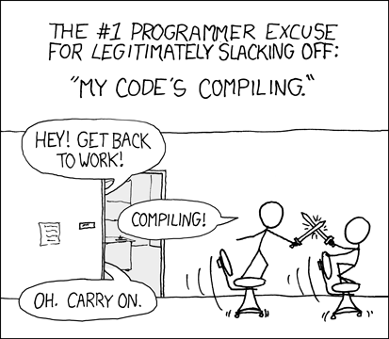
Notes:
And we, BE developers, are expert on those interruptions. And we have gotten so use to it, that we think it is unavoidable. We even have comics about it

Slide 13
A programmer takes between 10-15 minutes to start editing code after resuming work from an interruption.
http://blog.ninlabs.com/2013/01/programmer-interrupted/
Notes:
But maybe we are not aware of the real cost. There are several studies that try to quantify the cost of interruptions for us developers and it seems that the cost is quite high: it takes us between 10 and 15 to load back into our heads the context of the task that we were performing before the interruption. 10 minutes to be productive again. 10 minutes to context switch.

Slide 14
1.0 second is about the limit for the user's flow of thought to stay uninterrupted, even though the user will notice the delay.
10 seconds is about the limit for keeping the user's attention focused
From book Usability Engineering
Notes:
And the worrying thing is that if we look at what the usability experts say, it seems that to not lose your train of thought, interruptions cannot be longer than one second. And if an interruptions is longer than 10 seconds, there is a high chance that you will lose focus and will start fiddling with your phone, checking the news or reading your social media.
And who here is able to build and start an application in less than one second?

Slide 15
Time to compile and start a new Tomcat app
30 seconds
compiling …
done!
Notes:
Those are 30 seconds, and I am not not sure how it felt for you sitting there in the crowd, but for me standing up here in front of all of you, those 30 seconds where a very long 30 seconds.
And that is for an empty application, it is not going to get any better. And we do this all the time.

Slide 16
“Do not run Tomcat. Embrace TDD.”
Dan Lebrero
Notes:
But what can we do about it? If you want to stay productive, you will follow the advise of that wise man. You will avoid running your application, and instead, you will rely on a good test suite to give you the fast feedback to know that you are making progress and to know that you did not broke anything. And remember than for a test suite to be good, it must run under 10 seconds, because that our limit to not lose focus.
But if you have been doing TDD long enough, you know that TDD has two main shortcomings.

Slide 17




Stubs
Spies
More lies!
Mocks
Fakes
Lies
Big lies!
Lies!

Slide 18


Slide 19
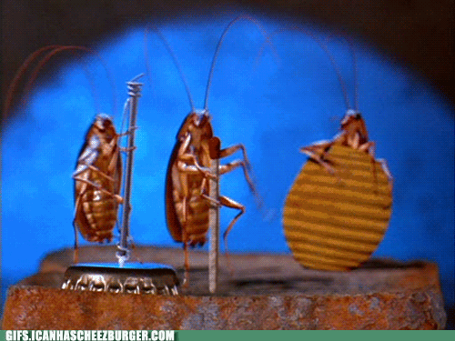

Slide 20
What do we want from our workflow?
Write code with immediate feedback
No build or deploy
Tools to understand the real world
Easy way of creating faithful lies for our tests
No surprises when starting the application

Slide 21
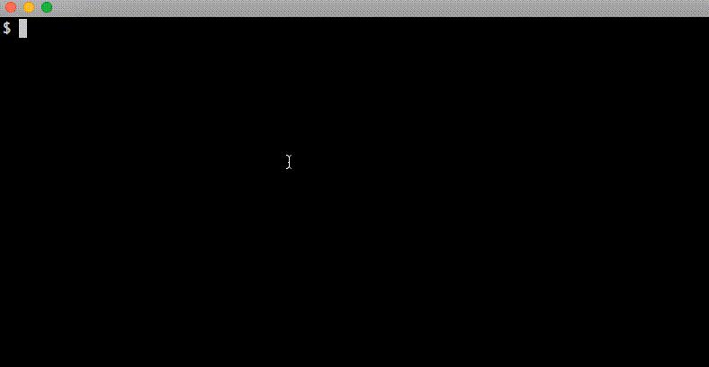
REPL
Read Eval Print Loop

Slide 22


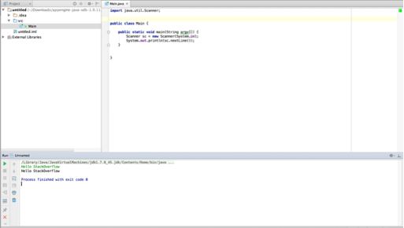

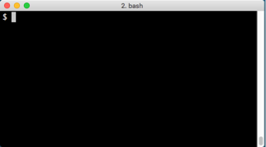
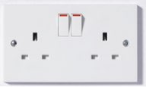
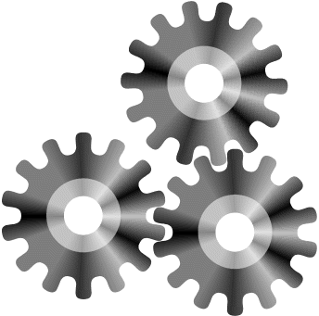
code
Our app
Results

Slide 23


Clojure

Slide 24
What do we want from our workflow?
Learn the language and libraries
Write code with immediate feedback
No build or deploy
Tools to understand the real world
Easy way of creating faithful lies for our tests
No surprises when starting the application

Slide 25
Demo time!

Slide 26
What do we get with a REPL workflow?
Learn the language and libraries
Write code with immediate feedback
No build or deploy
Tools to understand the real world
Easy way of creating faithful lies for our tests
Fewer surprises when starting the application
Add new libraries to a running application
Run automatically unit test affected by a change
Inspect and manage state
Stay on the comfort of your favourite IDE

Slide 27
Staging
Our App
Our App
Production

Slide 28
“in May of 1999. […] we were able to debug and fix a race condition that had not shown up during ground testing.
Debugging a program running on a $100M piece of hardware that is 100 million km away is an interesting experience. Having a read-eval-print loop running on the spacecraft proved invaluable in finding and fixing the problem”
Ron Garret - NASA Jet Propulsion Lab Engineer

Slide 29
What do we get with a REPL workflow?
Learn the language and libraries
Write code with immediate feedback
No build or deploy
Tools to understand the real world
Easy way of creating faithful lies for our tests
Fewer surprises when starting the application
Add new libraries to a running application
Run automatically unit test affected by a change
Inspect and manage state
Stay in the comfort of your favourite IDE
Debug staging and production
Control spacecrafts

Slide 30
Joy
compiling next slide…
Productivity

Slide 31
Javascript: https://vimeo.com/123513496
ClojureScript: https://www.youtube.com/watch?v=KZjFVdU8VLI
Elm: http://debug.elm-lang.org/
Groovy: https://www.youtube.com/watch?v=bTRUC78X87g
Python: https://www.youtube.com/watch?v=EwI-e3WlTew
iOS: https://www.youtube.com/watch?v=Ci4uviG8S0o
Android: https://www.youtube.com/watch?v=mVXTcAEKgF8
Unity: https://www.youtube.com/watch?v=tJr_TD1BtF0
Music: https://www.youtube.com/watch?v=yY1FSsUV-8c

Slide 32

What about the Java 9 REPL?

Slide 33
References
– The code
https://github.com/dlebrero/repl-driven-development-talk
– Bret Victor – Inventing by principle
https://vimeo.com/36579366
– Ron Garret – The Remote Agent Experiment: Debugging Code from 60 Million Miles Away
https://www.youtube.com/watch?v=_gZK0tW8EhQ
– Jakob Nielsen – Usability Engineering
https://www.nngroup.com/books/usability-engineering/

Slide 34

???
@DanLebrero
dlebrero@gmail.com
danlebrero.com
@Akvo
https://akvo.org/

